Slide 1
3 Axis Pin Dev. Update
Week #15

Slide 2
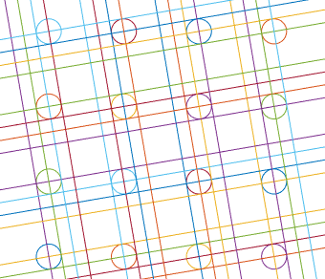
Stringing Algorithm
Given a particular arrangement of pins
Loop over each pin to find theta values of stringing (two lines perpendicular to each other)
Such that the strings do not intersect with the movement radius (1mm)
One possible arrangement (not optimized for spacing distance)

Slide 3
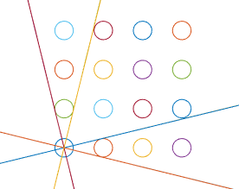
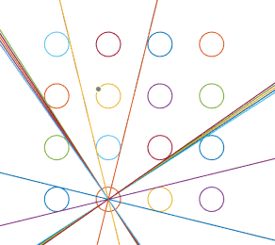
Results
Minimum Spacing Distance between pins is ~4.25 mm (we wanted 2.5 in the original plan)
Only 4 pin types due to symmetry, best to string in high density regions

Slide 4
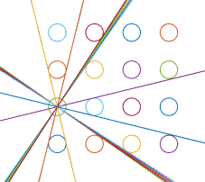

Results Part 2

Slide 5
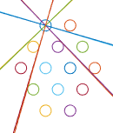

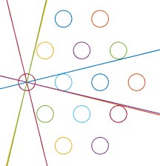
Results Part 3
Tested the arrangement of the original pin array - minimum distance between pins is ~4.375 (slightly better than square array, but not by much)

Slide 6
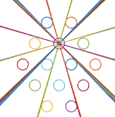
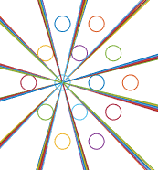

Slide 7

Next Steps
Keep testing various geometries (rigid frames seems a bit challenging to implement)
Maybe make a function that parametrizes pin placements and attempt to find minimum spacing distance for each arrangement, then find most optimal placement?
More Hexagonal Patterns?
Continue to develop rigid frames
Pulley
Motor

